Slide 1
ANTswers
Your Interactive FAQ
Danielle Kane
Research Librarian for Emerging Technologies and Service Innovation
Hacking Reference: Engaging the "Whole Student“
CARLDIG-S Fall Program 12/5/2014
Notes:
Enhance (not replace) current reference services
Serve a large number of people at any one time of the day
Serve a wide range of library patrons
Triage patrons: Many reference questions are repetitive, such as “where is the stapler” and “how do I print.”
Provide consistent answers
Refer the library user to a librarian if the question is more complicated

Slide 2
Project Phases
Development Phase (August - September 2013)
Loading of files and setup
Explore software, determining process, learning AIML
Team Phase (August – September 2013)
Scope, coverage, resources
Personality, look, and feel
Prototype Phase (September – December 2013)
Program library content & review general content
Team members tested files
Testing Phase (January – March 2014)
Internal test - with all library staff
External test – ANTswers Beta was released

Slide 3
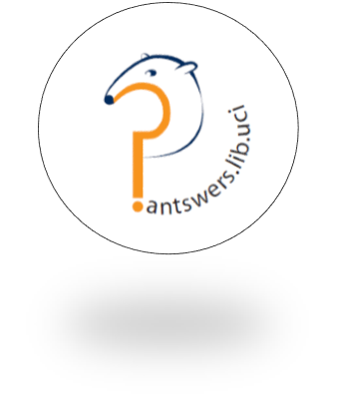
ANTswers by the Numbers
Total ANTswers AIML Files
Number of Questions Asked
988 (L)
733 (G)
1,714
120 Files
66 Subject
29
Conversation
20
Library
6 Ready Reference + 2 Bot
Notes:
84,618 categories - 60 - 70 % of those files are general conversation

Slide 4
Notes:
Update charts before sending slides

Slide 5
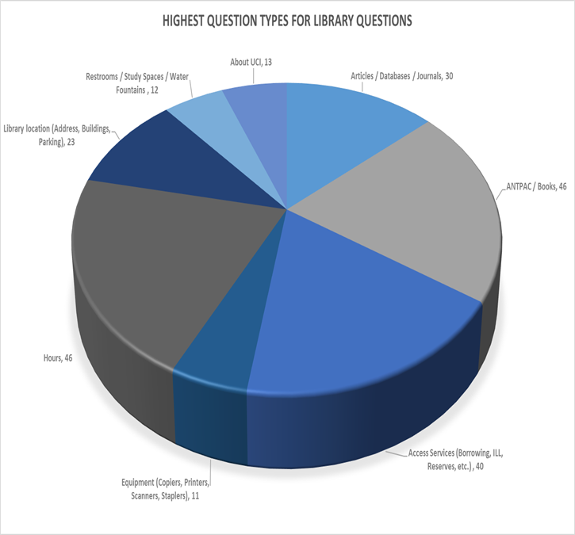

Slide 6
Do you want to build a chatbot?
Download our files! https://escholarship.org/uc/uci_libs_antswers
Support Documentation : http://goo.gl/ronxRb
Updating ANTswers
AIML Cheat Sheet
Project Plan
Contact Danielle Kane: kaned@uci.edu

Slide 7
ANTswers Live
Antswers.lib.uci

