Slide 1
Connecting, Collaborating, Creating: Advancing Equitable Teaching in the Library
Ariel Deardorff, Director of Data Science and Open Scholarship
Lisa Leiva, Head of Instructional Design
Holly Thompson, Director of Education and Clinical Research Services
University of California, San Francisco Library

Slide 2
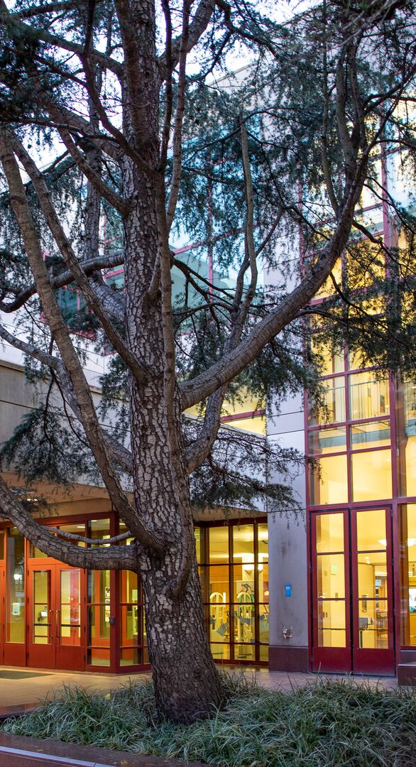
About UCSF Library
UCSF: health science, graduate-only campus
50 Library staff, teaching expertise spread across multiple teams:
  Data science and open scholarship
  Education and clinical research
  Archives and special collections
  Instructional design
Lots of siloed teaching within and across teams
Changing expectations around accessibility and universal design for learning

Slide 3
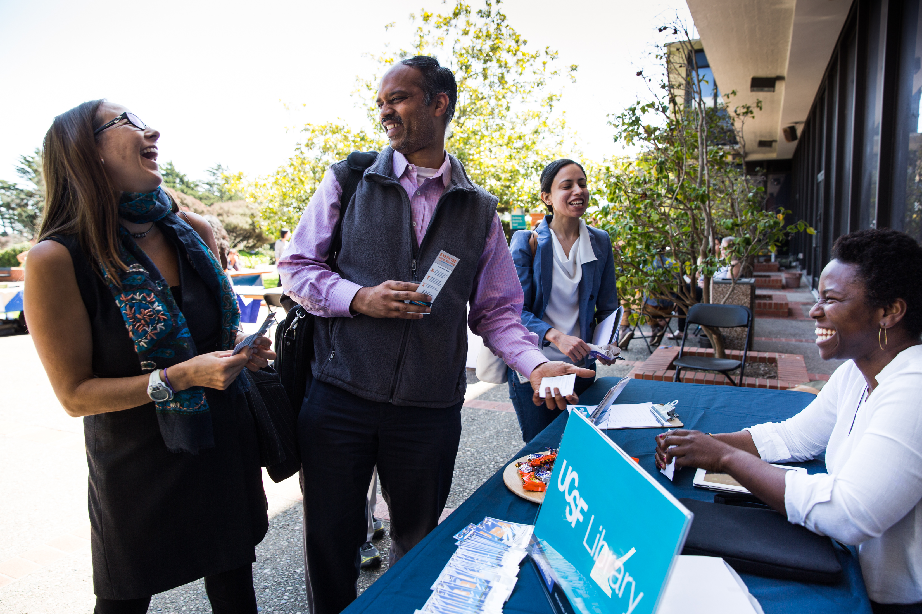
Equitable Teaching Project Charge
2022-2026 UCSF Library Strategic Plan
"Develop and implement best practices for equitable and inclusive library teaching, increasing and empowering collaboration across the library through shared expertise."
Project ran from Aug 2022 – Nov 2025

Slide 4
Our Project Team
Ariel Deardorff (co-lead) - Data Science and Open Scholarship
Lisa Leiva (co-lead) - Instructional Design
Holly Thompson (co-lead) - Education and Clinical Research
Josephine Tan - Education and Clinical Research
Lisa Nguyen – Archives and Special Collections
Dylan Romero – Library Operations
Alumni:
Jill Barr-Walker - Education and Clinical Research
Charlie Macquarie - Archives and Special Collections

Slide 5
Project Goals
Goal 1: Create a community for UCSF Library educators to build a culture of collaboration, solidarity, and vulnerability.
Goal 2: Create a teaching guide for UCSF Library Educators with resources on teaching practices, technology, and outreach that incorporates DEI approaches to teaching and learning.
  DEI to be integrated throughout, not just siloed in one section
  Wanted teaching information to be accessible to everyone in the library

Slide 6
Library Educators Community of Practice
Launched the Library Educators Community of Practice in Oct 2023
  Virtual community group open to all Library staff, facilitated by Ariel and Lisa L.
  Also has a slack channel in the Library Slack
Created a charter to define roles and responsibilities, and sustainability plan
Hosted 15 bi-monthly community meetings - Between 9-16 attendees
  Topics included: Disability accommodations, Universal Design for Learning, How AI is Changing my Teaching, and more
  Mix of presentations from library staff, invited speakers, and group discussions
In 2026, Lisa L. onboarded a new co-facilitator and they have hosted 3 meet ups so far

Slide 7
Inclusive Teaching Guide for Library Educators
The (lib)guide officially launched in Oct 2025
  Includes content on creating learning objectives, backward design, creating accessible learning materials, scheduling logistics, and more!
  Integrates DEI best practices everywhere (not just in one section)
    Logistics: prioritize accessible spaces (e.g., working mics, wheelchair access)
    Instructional design: center learner voices (e.g., provide opportunities to share expertise)
  Library Educator's tips highlighted throughout
Holly will maintain the guide going forward, sending out quarterly reminders for new content and tips

Slide 8
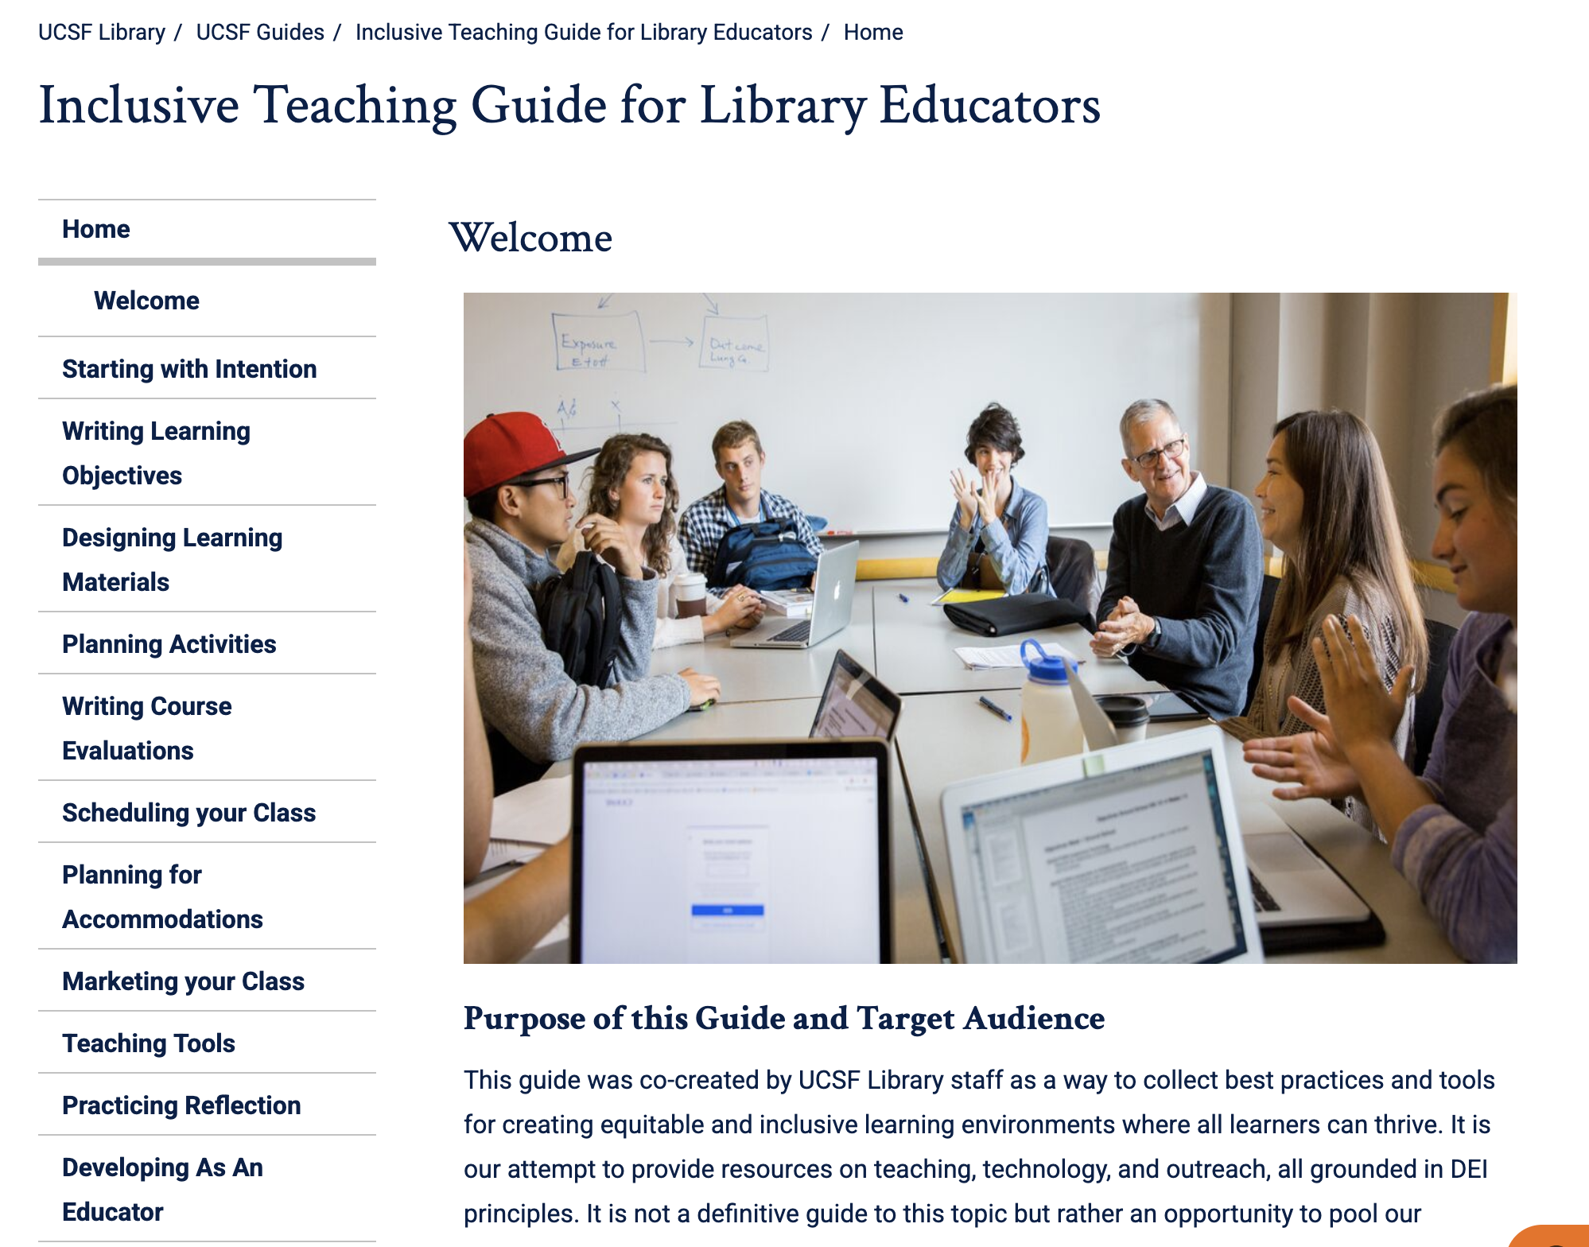
Picture of Library Educators Guide
8

Slide 9
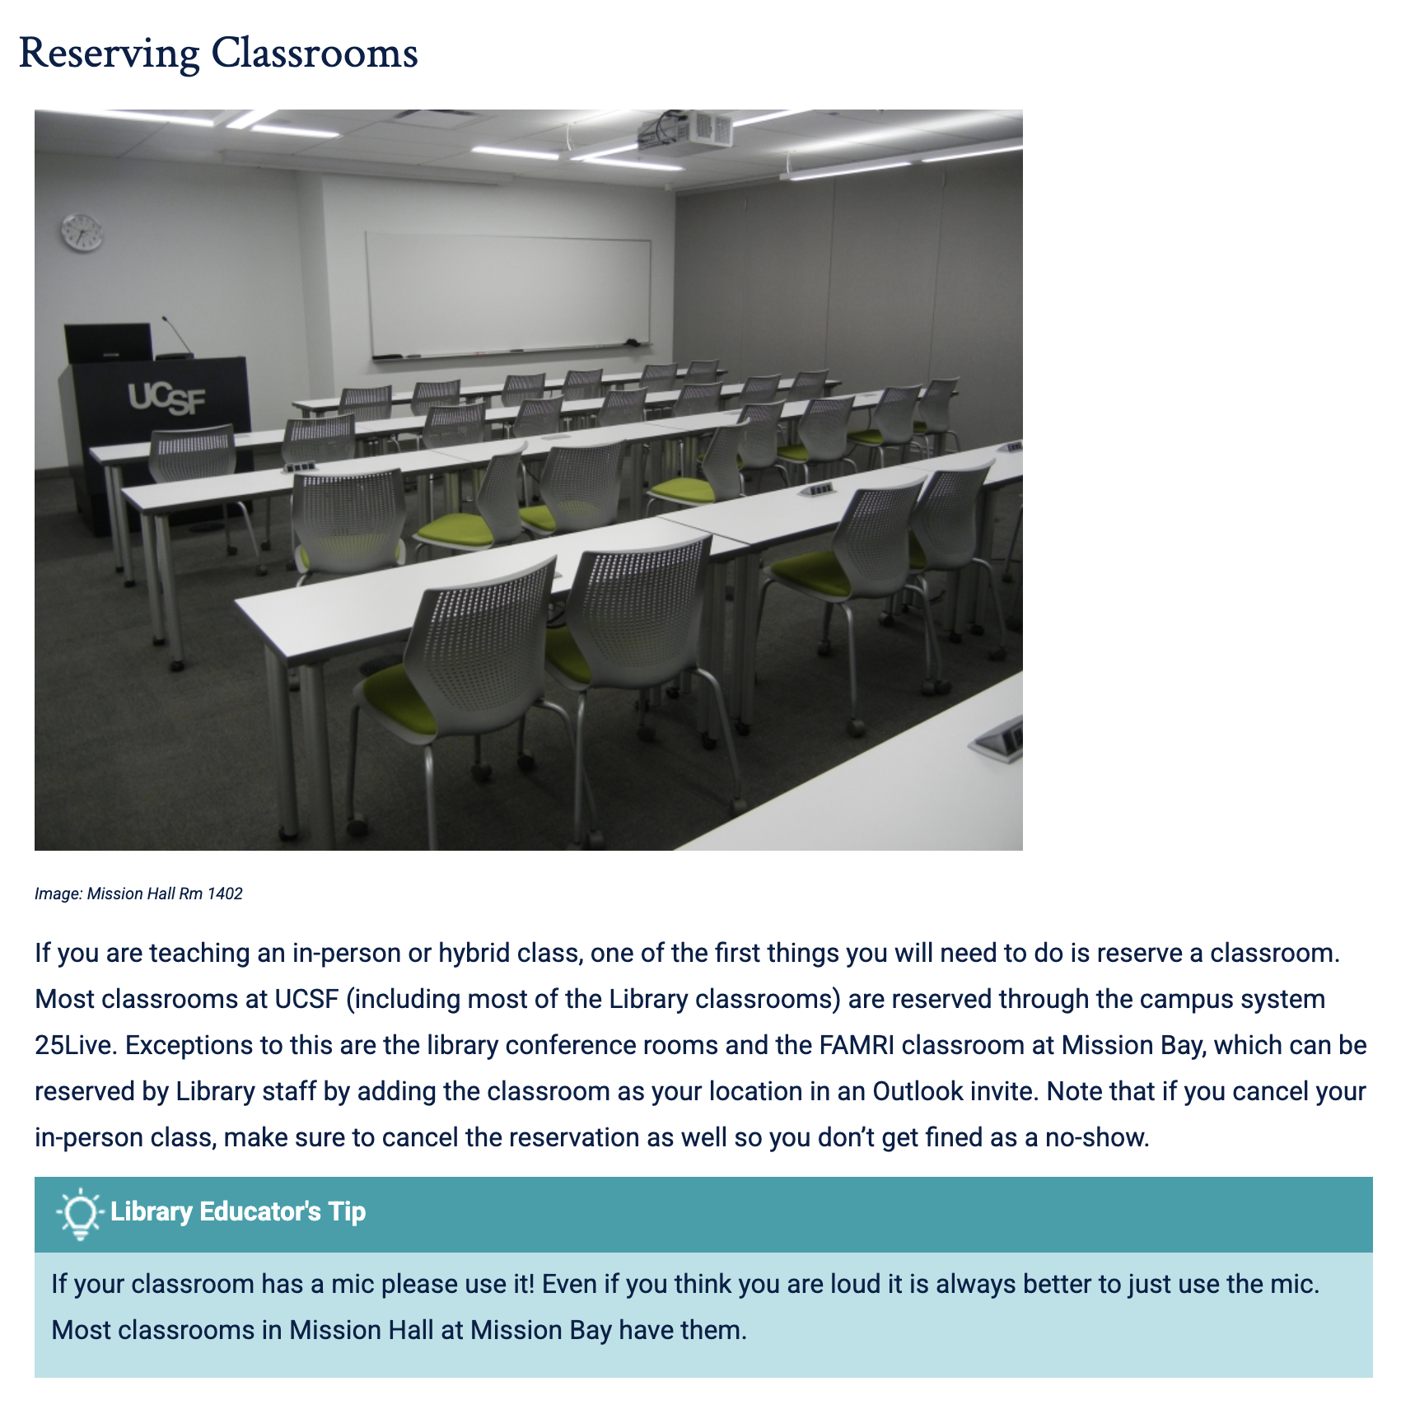
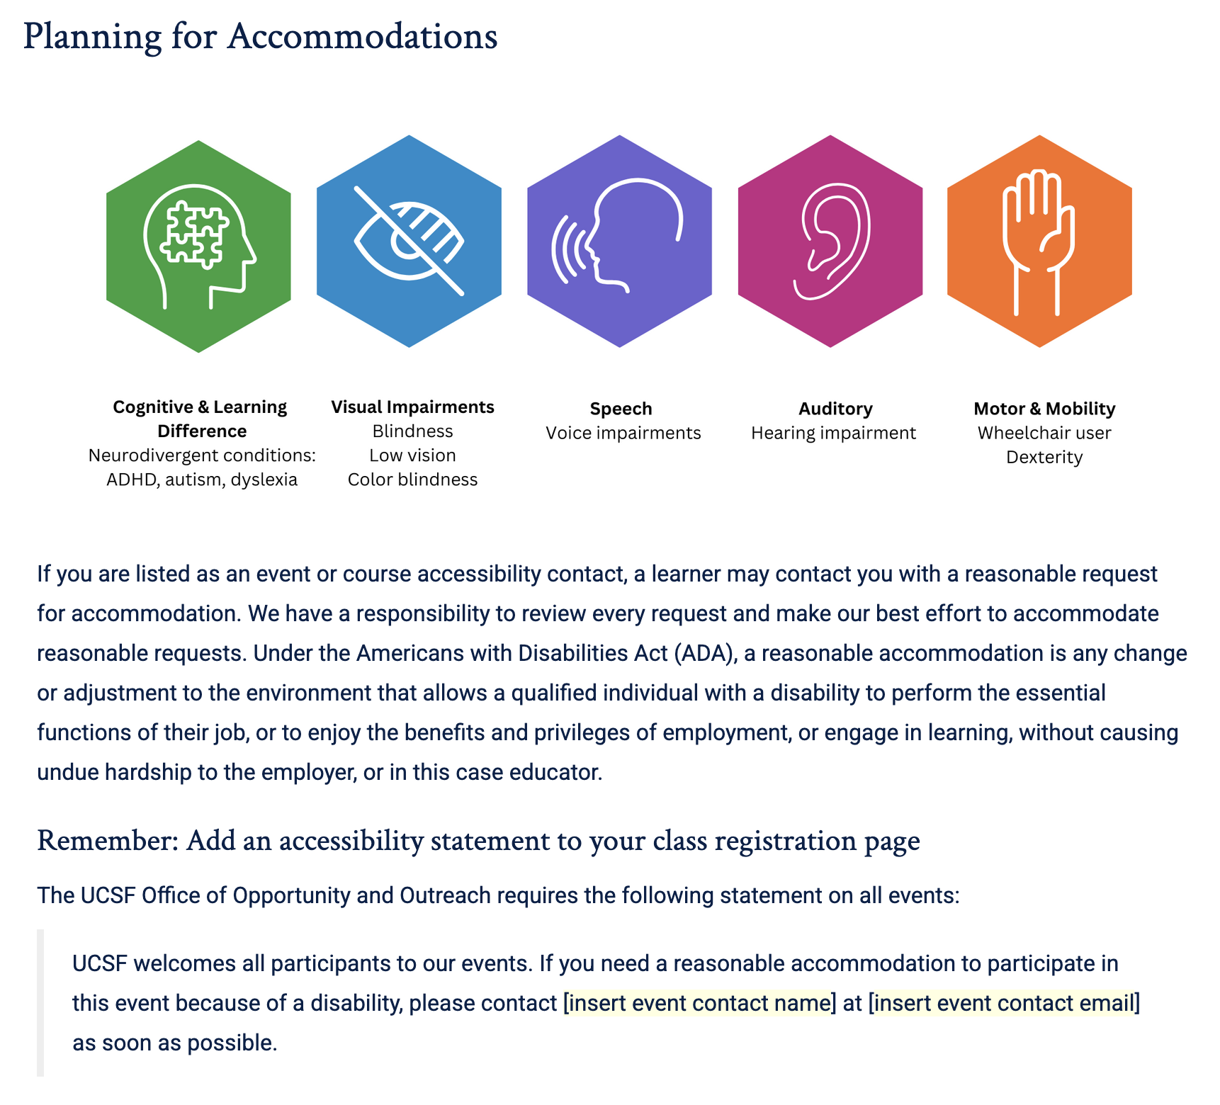
Pictures from Library Educators Guide

Slide 10
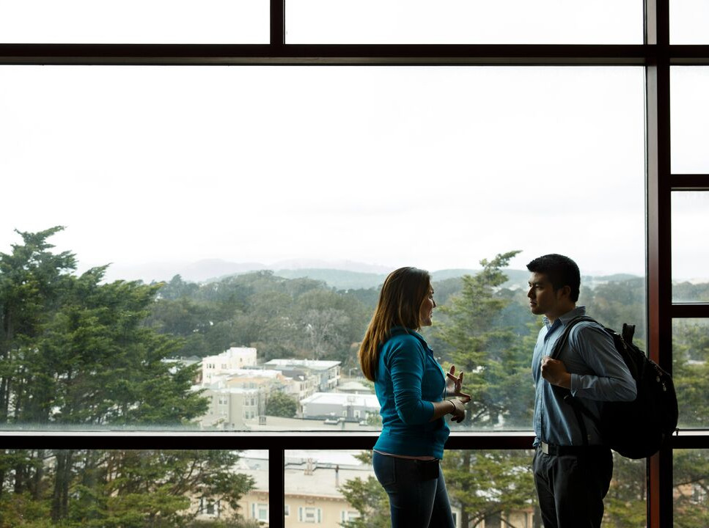
Outcomes
Library Educators Community has helped build connections across library teams, given library staff a place to share their work
ET Project led to more awareness of accessibility requirements and a forum to translate requirements and best practices into concrete actions
The guide has made it much easier to onboard new library educators and find teaching information

Slide 11
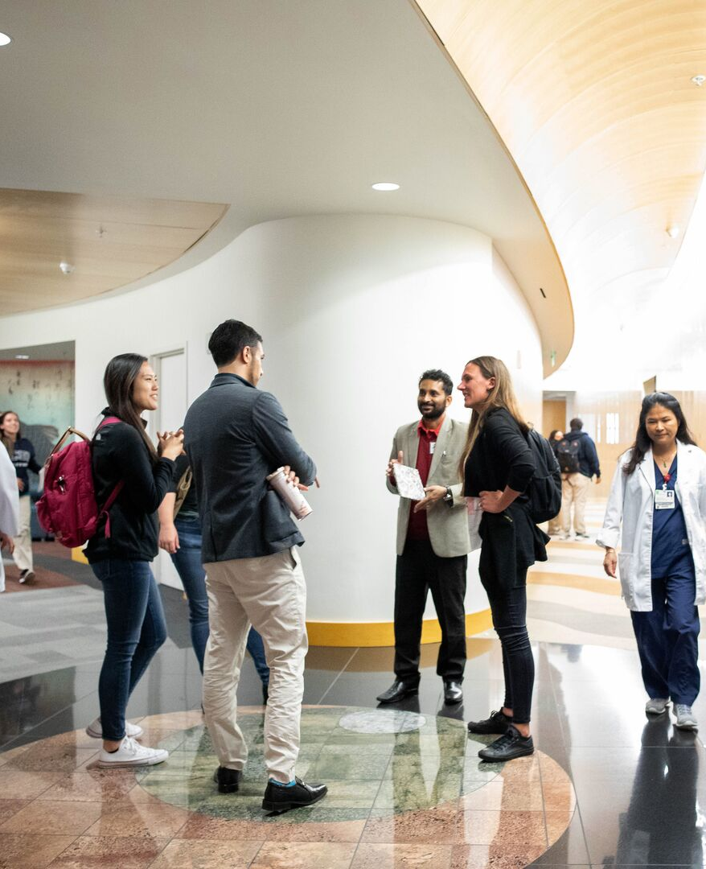
Reflections and Recommendations
Project work could have been completed faster if we had been more flexible with our meeting timing and structure throughout
  sometimes you might need a working meeting or to meet more often for a period to accomplish a particular goal
Plan for team transitions – folks will likely come and go
Have an end in sight and finish strong with reflections, sustainability plans, and celebration!

Slide 12
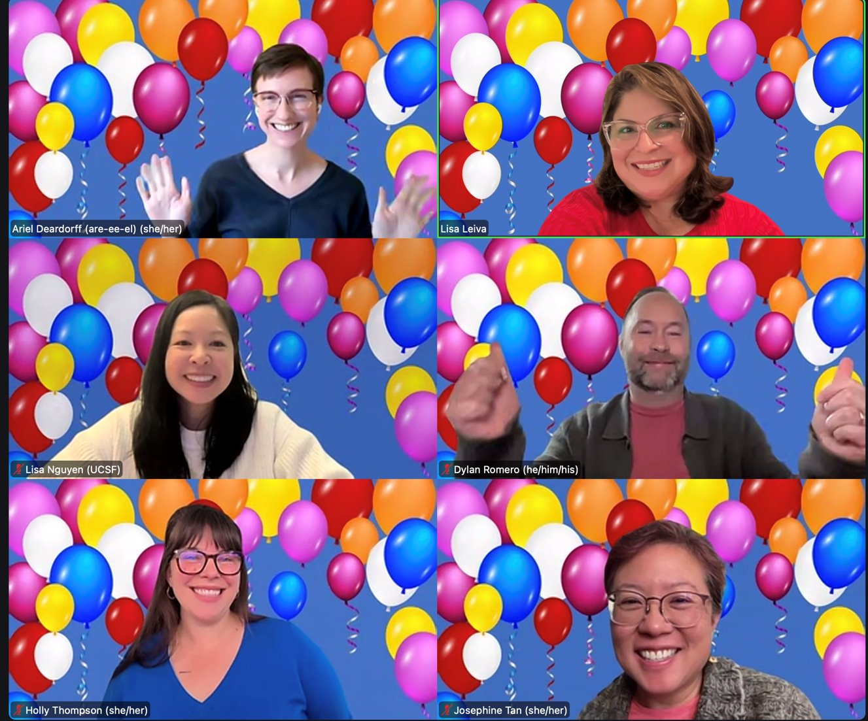
Thanks!
Email: ariel.deardorff@ucsf.edu
Inclusive Teaching Guide: guides.ucsf.edu/InclusiveTeachingGuide

