Slide 1
AI in Your Toolkit
Critical Approaches to Using AI in your Work
Ariel Deardorff, MLIS
Director of Data Science and Open Scholarship
University of California, San Francisco Library

Slide 2
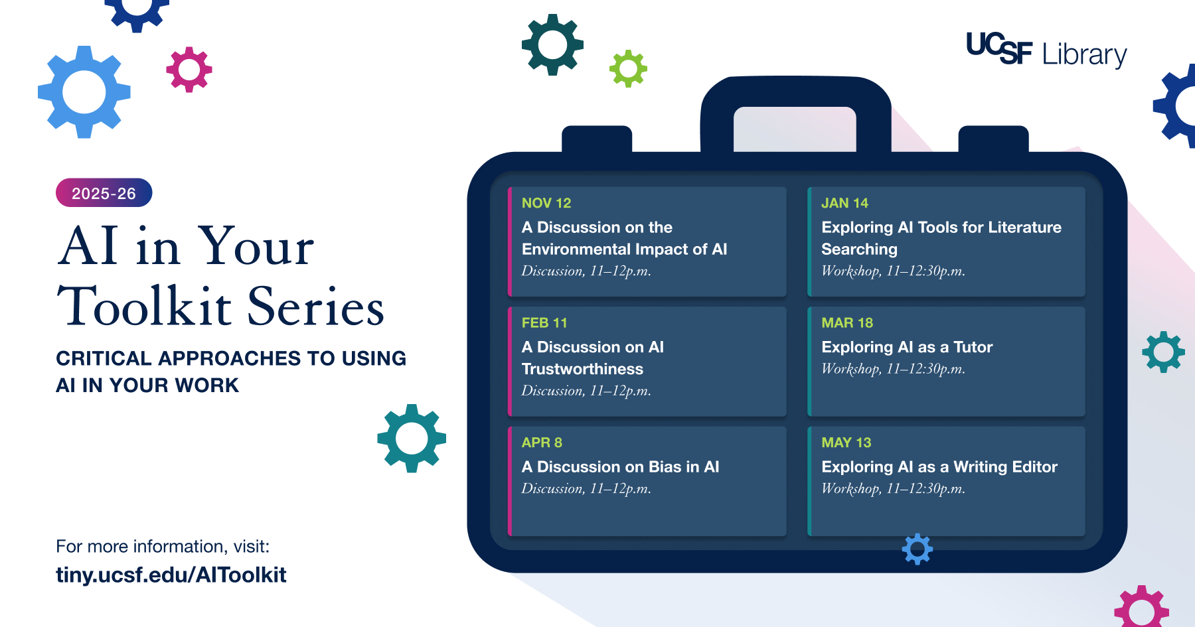
Poster for AI in your Toolkit
Notes:
6 virtual workshops that ran from Nov 2025-May 2026
Open to everyone at UCSF
sessions divided between 3 ethical discussion (name) 3 hands on workshops (name)
Important to include these ethical discussions as there had been a lot of promotion and talk of AI on campus and we wanted to focus on how to work with these tools critically

Slide 3
AI in your Toolkit Team:
Eileen Chen, Education and Research Librarian
Yea-Hung Chen, Data Science Specialist
Ariel Deardorff, Director of Data Science and Open Scholarship
Josephine Tan, Education and Research Librarian
Holly Thompson, Director of Education and Clinical Research Services
Lisa Leiva, Head of Instructional Design
Anneliese Taylor, Head of Scholarly Communication
Jessica Crosby, Outreach and Marketing Coordinator
Sumaiya Elahi, User Experience Designer
Notes:
Took collaboration from library staff from several teams, including my team – data science and open scholarship, education and research librarians, marketing, user experience, etc

Slide 4
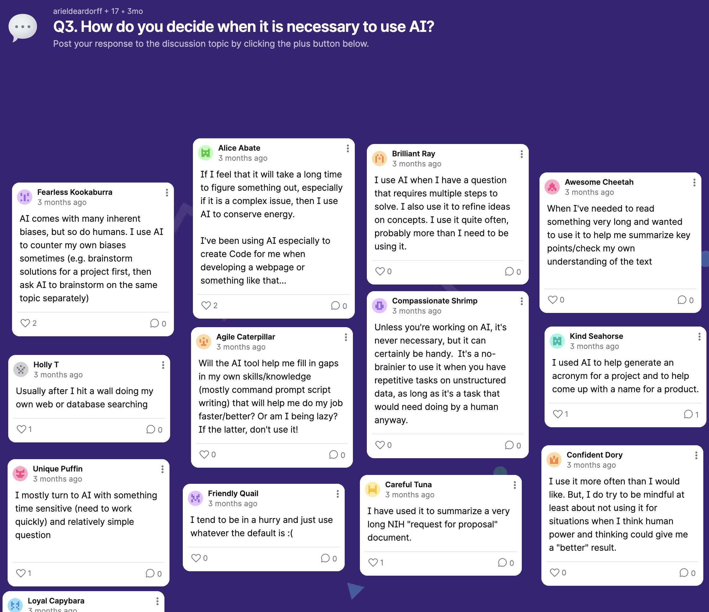
How did it go?
30 - 100 attendees per workshop (average 55)
Strong audience engagement in the Padlets (virtual whiteboards) & zoom chat
Lots of encouraging feedback – attendees liked the focus on building skills rather than specific tools
Our team members have been invited to give several follow up presentations to various faculty groups and departments
Notes:
Discussion club focused on connection and discussion

Slide 5
How did it impact our staff?
Benefits of the workshop series
Chance to learn about and try out AI tools together
Led to stronger collaborations across the library – led to subsequent AI discussions and projects within the Library
Established us as a major player in AI literacy training on campus
Next Steps
In-person AI discussion club this summer
New AI workshop series in the fall
Notes:
Discussion club – chance to discuss AI in a smaller and more community driven setting

Slide 6
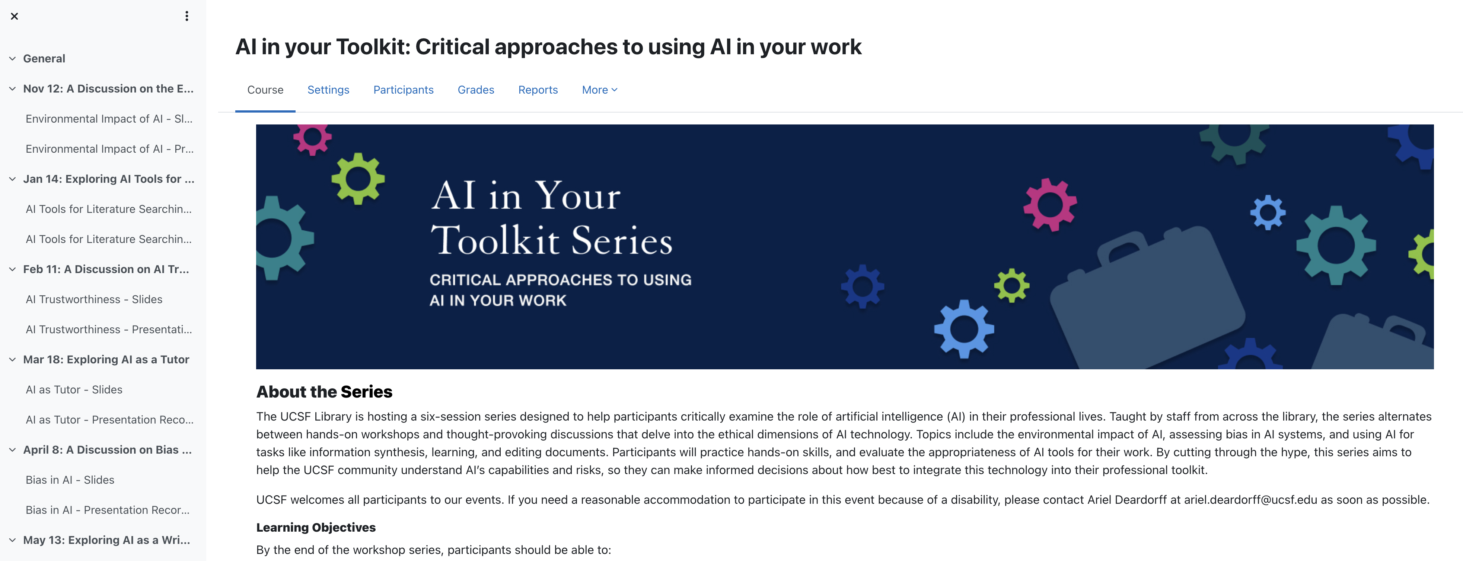
Want to learn more?
Visit the course website at tiny.ucsf.edu/AItoolkit

